Slide 1
Natural Language Processing Workshop
Session 1

Slide 2
Content
Exercise: Build your first bot
What is chatbot & Type of Chatbots
What is Rasa?
Review chatbot architecture

Slide 3
Exercise: 1
Build your first chatbot

Slide 4
Exercise: Chatbot to cheer you up
Open folder exercise-1
Follow the instructions

Slide 5
Chatbot & Type
What is chatbot & type of chatbot

Slide 6
Chatbot
Conversational assistant
Suit your needs
Save your time

Slide 7
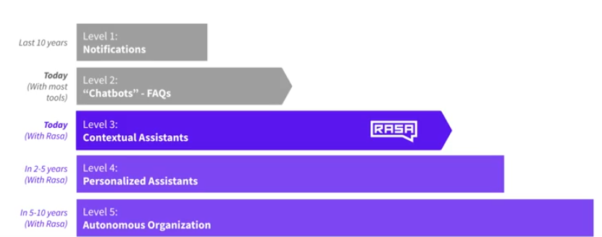
Types of Chatbots

Slide 8
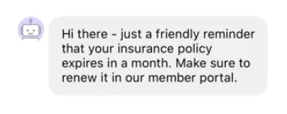
Types of Chatbots: Notification
SMS/Email assistants: Notifies you of order status.

Slide 9
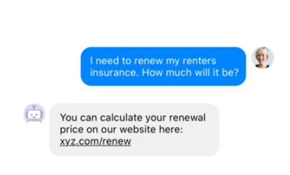
Types of Chatbots: FAQs assistants
Simple preconfigured – Differs from notification by follow up questions.
State machine – set of rules
State machines – Complex over time

Slide 10
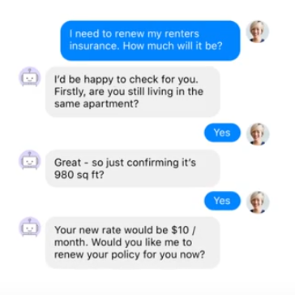
Types of Chatbots: Contextual assistants
Natural language understanding.
Understanding context
Context of conversation – recommend me a book → Harry potter → Is that fiction or non-fiction?
Handle unexpected conversation and chit chat

Slide 11
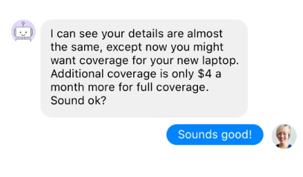
Types of Chatbots: Personalized assistants
Reviews your email/credit cards.
Remember your preferences.
Advice on insurance/investment portfolios

Slide 12
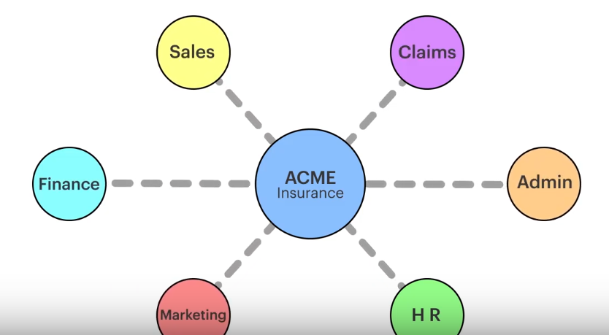
Types of Chatbots: Autonomous organization
Take over a wide portfolio.
Advice over wide variety of aspects.
Real life conversations

Slide 13
RASA
What is RASA & What can you do with it?

Slide 14
RASA
Rasa is a set of open source machine learning tools for developers for conversational AI.
TWO PARTS:
NLU: a natural language processing tool for intent classification and entity extraction.
Core: framework for machine learning based contextual decision making.

Slide 15
RASA: Architecture
Entities & Intents

Slide 16
RASA NLU: Intents and Entities
RASA NLU
Hello. My name is Dinesh.
Entity: Dinesh(Name)
Intent: Greeting

Slide 17
RASA CORE: Dialogue management & Decision making
Hi.
Next best action:
utter_ask_name: 89%
utter_greet_user: 11%
Hi, My name is Sara the chatbot. What is your name?

